Slide 1


2025-07-19
Introduction to Statistics Analysis and Basic Statistics for Data Analysis
Lesson - 330.2 - Introduction to Statistics Analysis and Basic Statistics for Data Analysis.pptx - 1

Slide 2

2025-07-19
Table of Contents
Overview of Statistics
Benefits of Statistics
Overview of Statistical Analysis
Types of Statistics
Types of Statistics: Descriptive Statistics
Types of Statistics: Inferential Statistics
What Is Linear Relationship?
What Is Regression?
Linear Regression
Simple Linear Regression
Multiple Linear Regression
Overview of Correlation
Correlation Coefficie﻿nt and Covariance
Lesson - 330.2 - Introduction to Statistics Analysis and Basic Statistics for Data Analysis.pptx - 2

Slide 3
2025-07-19
Introduction
In this lesson, we will explore basic concepts of statistics and statistics analysis. Statistics play an important role in understanding a given feature’s behavior and the relation they inherit. This lesson gives you a brief overview of Statistical terms and explains their types and benefits.
Data Analytics also involves knowledge of advanced mathematics and programming; and thereby, Statistics serves as the first step towards understanding the Data Science and Data Analytics process. The results obtained by using Statistics for Data Analytics have helped in generating insights from data that drive business growth in the industry to stay ahead in the competitive world.
Lesson - 330.2 - Introduction to Statistics Analysis and Basic Statistics for Data Analysis.pptx - 3

Slide 4
2025-07-19
Learning Objectives
By the end of this lesson, learners will be able to:
Describe fundamental concepts in data analytics and statistics, including descriptive and inferential statistics.
Define statistical methods to analyze data, including measures of central tendency, dispersion, and hypothesis testing.
Explain Linear Regression.
Describe the Statistical terms.
Explain Statistical types and benefits.
Define Linear Relationships.
Discuss the Correlation concept.
Lesson - 330.2 - Introduction to Statistics Analysis and Basic Statistics for Data Analysis.pptx - 4

Slide 5
2025-07-19
Overview of Statistics
Statistics is a branch of mathematics that deals with the collection, analysis, interpretation, and presentation of numerical or quantitative data. Everyday examples of statistics at work include:
Calculations such as average income, average age, highest-paid professions.
Clinical Trials: Researchers using statistics to analyze data from the production of vaccines to ensure safety and efficacy.
Economics and Finance: Market Research: Statistics help analyze market trends, consumer behavior, and preferences, enabling businesses to make informed decisions.
Climate Studies: Statistics are used to analyze climate data, model environmental changes, and assess the impact of human activities on the environment.
Machine Learning and Artificial Intelligence: Statistical methods form the foundation of many machine learning algorithms used in data analysis, pattern recognition, and predictive modeling.
Lesson - 330.2 - Introduction to Statistics Analysis and Basic Statistics for Data Analysis.pptx - 5

Slide 6
2025-07-19
Benefits of Statistics
Benefits of Statistics for Data Analytics:
Statistical methods are mainly useful to ensure that data is interpreted correctly and that apparent relationships are really “significant” or meaningful and not simply happenstance. Actually, the statistical analysis helps to find meaning to the meaningless numbers.
Statistics assists in gaining insight into business operations, making it an important aspect of any Data Science and Data Analytics project life cycle.
Apart from understanding statistical measures, statistics also plays a vital role in data preprocessing and feature engineering. It helps to visualize numbers to understand patterns and trends that exist in quantitative data.
The association of statistics with Data Science and Data Analytics has served as a base for several machine learning algorithms such as logistic regression, and many other algorithms that have evolved considering the importance of statistical summary.
Lesson - 330.2 - Introduction to Statistics Analysis and Basic Statistics for Data Analysis.pptx - 6

Slide 7
2025-07-19
Overview of Statistical Analysis
Statistical Analysis is the application of statistical methods to a sample of data in order to develop an understanding of what that data represents. It includes collecting and scrutinizing every data sample in a set of items from which samples can be drawn:
Sample: a representative selection drawn from a total population.
Population: a discrete group (people or things) that can be identified by at least one common characteristic for purposes of data collection and analysis.
For example, in a certain use case, population may be all of the people in a state that have a license to drive; a sample of this population that is a part or a subset of the population could be men drivers over the age of 50.
Lesson - 330.2 - Introduction to Statistics Analysis and Basic Statistics for Data Analysis.pptx - 7

Slide 8
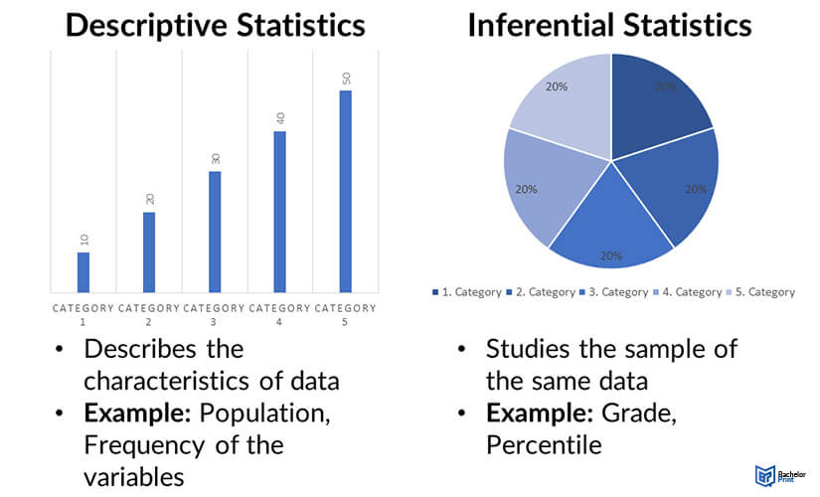
2025-07-19
Types of Statistics
We can view statistics from two perspectives: Descriptive and Inferential.
Descriptive statistics — Summarizing information about the sample.
Inferential statistics — Making inferences or generalizations about the broader population.
img src: jaroeducation/
Lesson - 330.2 - Introduction to Statistics Analysis and Basic Statistics for Data Analysis.pptx - 8

Slide 9
2025-07-19
Types of Statistics: Descriptive Statistics
Descriptive Statistics:
Enables you to present data in a meaningful way.
Allows simpler interpretation of the data.
Use of numerical data to summarize and describe the main features of a dataset.
Data is described using summary charts, tables, and graphs without any attempts to draw conclusions about the population from which the sample is taken.
The objective is to make it easier to understand and visualize raw data without making conclusions regarding any hypotheses that were made. For example, we want to describe the English test scores in a specific class (25 learners). We record the test scores of all learners, calculate the summary statistics, and produce a graph.
Some of the common measures of Descriptive Statistical Analysis include:
Central Tendency (Measure of Central Tendency).
Dispersion (Measure of Variability).
Descriptive Statistics
Central Tendency
Dispersion
Mean
Median
Mode
Range
Standard
Deviation
Variance
Per Scholas. 2025
Lesson - 330.2 - Introduction to Statistics Analysis and Basic Statistics for Data Analysis.pptx - 9

Slide 10
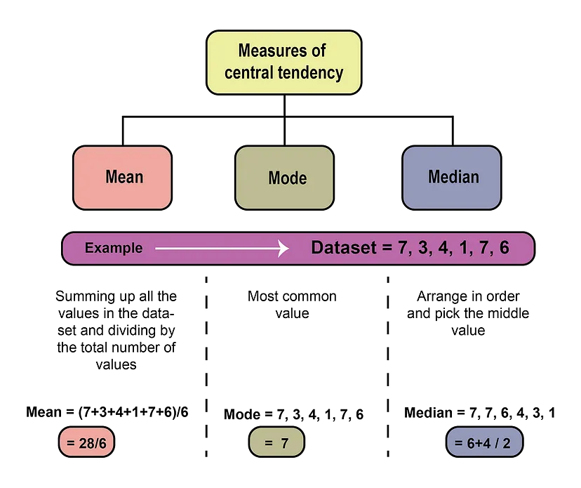
2025-07-19
Descriptive Statistics - Central Tendency (1 of 5)
Definition: Central tendency refers to the value derived from the random variables from the set of data that reflects the center of the data distribution.
Measures of central tendency: Helps you find the middle or the average of a dataset. The three most common measures of central tendency are the mean, mode, and median.
Example:
Lesson - 330.2 - Introduction to Statistics Analysis and Basic Statistics for Data Analysis.pptx - 10
Source: careerfoundry.com

Slide 11
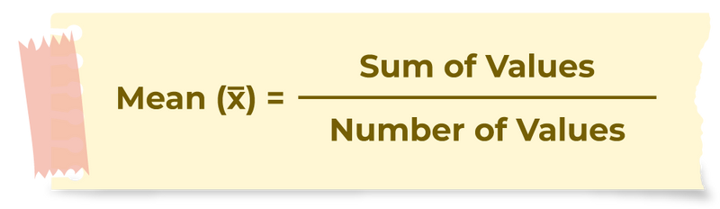
2025-07-19
Descriptive Statistics - Central Tendency (2 of 5)
Mean (Average): Calculating the average value of a dataset to understand its central tendency. It is calculated by summing all of the values and dividing them by the number of data points. The mean provides a measure of central tendency and helps in understanding the typical value in the dataset.
Example:
The ages of people in the checkout queue at Aldi are as follows: 23,54,2,6,20,25,21,64,19,19,75,36.23,54,2,6,20,25,21,64,19,19,75,36. Find the mean.
Solution: To find the mean add all of the observed numbers together then divide by the number of observations, which, in this case, is 12.
Mean = 23+54+2+6+20+25+21+64+19+19+75+3612 / 12
Mean = 364 / 12
Mean = 30.33333
Lesson - 330.2 - Introduction to Statistics Analysis and Basic Statistics for Data Analysis.pptx - 11

Slide 12
2025-07-19
Descriptive Statistics - Central Tendency (3 of 5)
Mode: Finding the most frequently occurring value in a dataset. It is a measure of central tendency that tells you the most popular choice or most common characteristic of your sample, especially in categorical data.
Mode = Highest Frequency value/item
Example: The ages of people in the checkout queue at Aldi are as follows: 23,54,2,6,20,25,21,64,19,19,75,36.23,54,2,6,20,25,21,64,19,19,75,36. Find the Mode.
Solution
The age that appears most frequently is the number 19; so the modal age is 19.
Lesson - 330.2 - Introduction to Statistics Analysis and Basic Statistics for Data Analysis.pptx - 12

Slide 13
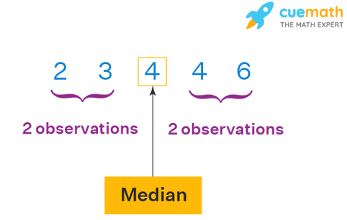
2025-07-19
Descriptive Statistics - Central Tendency (4 of 5)
Median: Identifying the middle value in a dataset, which is helpful in understanding the distribution when the data is arranged in ascending or descending order. It divides the dataset into two equal halves to find the median, first arranging the data in ascending or descending order, and then:
- If the number of data points (n) is odd, the median is the middle value.
Median = (n + 1) / 2
- If the number of data points (n) is even, take the two middle numbers, add them together and divide by 2.
Median = middle number One (n1 ) + middle number (n2) two
_____________________________________
2
Lesson - 330.2 - Introduction to Statistics Analysis and Basic Statistics for Data Analysis.pptx - 13

Slide 14
2025-07-19
Descriptive Statistics - Central Tendency (5 of 5)
Median Example 1:
To find the median, order the numbers in ascending and see which one is in the middle of the list.
E.g 1:For the data set 1, 1, 2, 5, 6, 6, 9 the median is 5.
E.g 2: For the data set 1, 1, 2, 6, 6, 9 the median is 4. Take the mean of 2 and 6 or, (2+6)/2 = 4.
E.g 3: For the data set 3, 3, 6, 13, 100 the median is 6.
E.g 4:For the data set 12, 13, 14, 14, 14, 15, 16, 17, Take the mean of 14 and 14 or (14 + 14/2) = 14 So, in both cases, the median is 14.
E.g 5: The ages of people in the checkout queue at Aldi are as follows: 3,54,2,6,20,25,21,64,19,19,75,36.23,54,2,6,20,25,21,64,19,19,75,36. To find the median first reorder the numbers in terms of size. 2,6,19,19,20,21,23,25,36,54,64,75.2,6,19,19,20,21,23,25,36,54,64,75.
The number of data entries is 12, so the position of the median is : (12+1 / 2) => 13/2 => 6.5 .
This means the median is between the 66th and 77th values, which are 21 and 23 respectively. In this case we compute:
21+23 / 2 = 22 .
So 22 is the median age of people in the checkout queue at Aldi.
Lesson - 330.2 - Introduction to Statistics Analysis and Basic Statistics for Data Analysis.pptx - 14

Slide 15
2025-07-19
Example: Salaries (1 of 2)
Objective: Let’s analyze a dataset of company salaries to understand when to use the mean, median, and mode, and how each measure provides different insights into salary distribution, especially in the presence of outliers.
Imagine that we are looking at the annual salaries of employees at a company. Normally, these salaries would be in the thousands, but to make it simpler, we are going to ignore the extra zeros for now.
Here is the list of salaries we will work with: 28, 29, 30, 30, 30, 31, 33, 35, 42, 45, 45, 47, 54, 88, 97, and 185.
This data represents employees across the entire company from those who just started in senior leadership.
1. Finding the Mean
First, let’s calculate the mean (or the average). To do this, we add up all of the salaries:
28 + 29 + 30 + 30 + 30 + 31 + 33 + 35 + 42 + 45 + 45 + 47 + 54 + 88 + 97 + 185 = 849.
Now, we divide the total by the number of employees (which is 16):
849 ÷ 16 = 53. So, the mean salary is 53.
2. Finding the Median
Next, let's calculate the median. Our numbers are already sorted. Since there are 16 values, the median will be the average of the 8th and 9th numbers (35 and 42):
(35 + 42) ÷ 2 = 38.5. So, the median salary is 38.5.
Lesson - 330.2 - Introduction to Statistics Analysis and Basic Statistics for Data Analysis.pptx - 15

Slide 16
2025-07-19
Example: Salaries (2 of 2)
3. Finding the Mode
The mode is the value that appears most frequently in the data. Here, the number 30 appears three times, which is more than any other number. So, the mode salary is 30.
Understanding the Results:
Now, what do these values tell us?
The mean salary (53) gives us the average, but it is affected by the very high salary of 185, which pulls the average higher than what most employees earn.
The median salary (38.5) is a better reflection of what most employees are actually earning, as it is not influenced by the extreme values.
The mode (30) tells us that 30 is the most common salary in this company, which could be useful for those looking to apply and wondering what salary they are likely to get.
This is how you can use mean, median, and mode to get different insights from the same dataset!
Lesson - 330.2 - Introduction to Statistics Analysis and Basic Statistics for Data Analysis.pptx - 16

Slide 17
2025-07-19
Practice Activities - Central Tendency
Practice Activity 1: Click here - Khan Academy's test on finding the mean, median, and mode
Practice Activity 2: Click here - Calculating the mean, median, and mode
Lesson - 330.2 - Introduction to Statistics Analysis and Basic Statistics for Data Analysis.pptx - 17

Slide 18
2025-07-19
Types of Statistics: Dispersion (1 of 5)
Definition:
Dispersion is the measure of variability in a dataset. Variability describes how far apart data points lie from each other and from the center of a distribution. Along with measures of central tendency, measures of variability give you descriptive statistics that summarize your data.
Understanding variability can help you grasp the likelihood of an event happening.
It is most commonly measured with the following:
Range: difference between the highest and lowest values.
Standard deviation: average distance from the mean.
Variance: average of squared distances from the mean.
These measures help to understand the distribution and consistency of data.
Lesson - 330.2 - Introduction to Statistics Analysis and Basic Statistics for Data Analysis.pptx - 18

Slide 19
2025-07-19
Types of Statistics: Disper﻿sion (2 of 5)
Standard Deviation (σ): The standard deviation (σ) measures the spread (or dispersion) of data points around the mean. It quantifies the variability or uncertainty in the dataset, with higher values indicating more scattered data points. There are six steps for finding the standard deviation by hand:
List each score and find their mean.
Subtract the mean from each score to get the deviation from the mean.
Square each of the deviations.
Add up all of the squared deviations.
Divide the sum of the squared deviations by n – 1 (for a sample) or N (for a population).
Find the square root of the number you found.
The standard deviation (σ) is a measure of how much a data set varies.
In the actual case, the sample population is calculated where n is the size of the sample and n-1 is the considered sample size.
Visit the Wiki Document for more information about Standard Deviation.
Lesson - 330.2 - Introduction to Statistics Analysis and Basic Statistics for Data Analysis.pptx - 19

Slide 20
2025-07-19
Types of Statistics: Disper﻿sion (3 of 5)
Click here to Watch video for Standard Deviation.
Standard Deviation Example:
For the standard deviation example, find the lab GLAB 330.2.2 - Example: Standard deviation on Canvas under Assignment section.
Lesson - 330.2 - Introduction to Statistics Analysis and Basic Statistics for Data Analysis.pptx - 20

Slide 21
2025-07-19
Types of Statistics: Dispersion (4 of 5)
Variance (σ2): Defines how far away the data points fall from the mean (center), that is distribution of values.
When a distribution has lower variability --> the values in a dataset are more consistent.
When a distribution has higher variability --> the data points are more dissimilar.
How Do I Calculate Variance?
Follow these steps to compute variance:
Calculate the mean of the data.
Find each data point's difference from the mean value.
Square each of these values.
Add up all of the squared values.
Divide this sum of squares by n – 1 (for a sample) or N (for the population).
KEY TAKEAWAYS
Variance is a measurement of the spread between numbers in a data set.
Investors use variance to see how much risk an investment carries and whether it will be profitable.
Variance is also used in finance to compare the relative performance of each asset in a portfolio to achieve the best asset allocation.
Click here for more information about Variance
Lesson - 330.2 - Introduction to Statistics Analysis and Basic Statistics for Data Analysis.pptx - 21

Slide 22
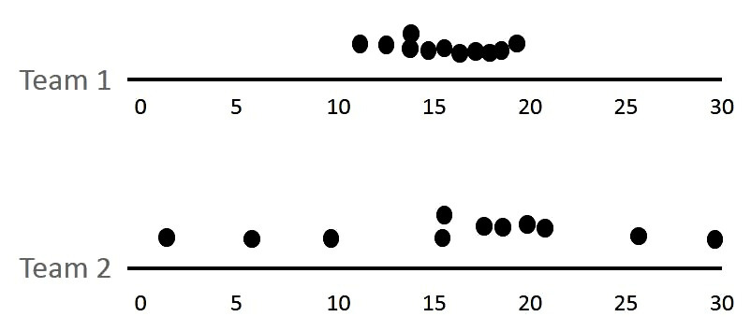
2025-07-19
Types of Statistics: Disper﻿sion (5 of 5)
Range : The range is the difference between the maximum and the minimum values in the dataset. It gives a simple measure of data spread, but is sensitive to outliers and extreme values.
How Do I Calculate Range?
The formula to calculate the range is:
R = H - L
R = range
H = highest value
L = lowest value
When both teams are considered, their Mode= 14.1, Median=15, and Mean=15. This implies that in order to accurately describe a distribution, you may require more information than the measurements of central tendency. Range is a measure of variability that comes into play in this situation. For the preceding example, the range will be:
(Team1) Range = 19.3 - 10.8 = 8.5
(Team2) Range = 27.7 - 0 = 27.7
Lesson - 330.2 - Introduction to Statistics Analysis and Basic Statistics for Data Analysis.pptx - 22

Slide 23
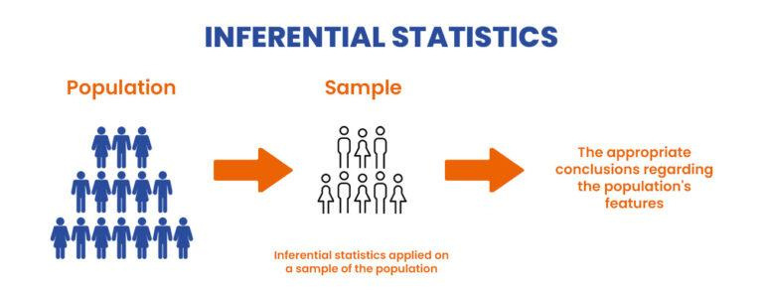
2025-07-19
Types of Statistics: Inferential Statistics
Inferential statistics:
The purpose of Inferential Statistics is to make predictions about a population based on a sample of data. Mainly used to derive estimates about a large group (or population) and draw conclusions on the data based on hypotheses testing methods.
Uses sample data because it is more cost-effective and less tedious than collecting data from an entire population.
Uses methods of inferential statistics so that you can draw generalizations that apply the results of the sample to the population as a whole.
purpose of Inferential Statistics?
Some common methodologies of Inferential
Statistics include:
Hypothesis Testing
Confidence Intervals
Regression Analysis
Lesson - 330.2 - Introduction to Statistics Analysis and Basic Statistics for Data Analysis.pptx - 23

Slide 24
2025-07-19
Types of Statistics: Inferential Statistics
Hypothesis Testing — Hypothesis testing makes use of inferential statistics and is used to analyze relationships between variables and make population comparisons through the use of sample data. For example, for studying the effectiveness of a vaccine by comparing outcomes in a control group, hypothesis tests can tell you whether the efficacy of a vaccine observed in a control group is likely to exist in the population as well.
Confidence Intervals — Confidence Intervals incorporate the uncertainty and sample errors to create a range of values the actual population value is likely to fall within.
Regression Analysis — Regression Analysis incorporates hypothesis tests that help determine whether the relationships observed in the sample data actually exist in the population rather than just the sample.
Lesson - 330.2 - Introduction to Statistics Analysis and Basic Statistics for Data Analysis.pptx - 24

Slide 25
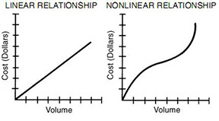

2025-07-19
What Is a Linear Relationship?
A linear relationship (or linear association) is a statistical term used to describe a straight-line relationship between two variables. Linear relationships can be expressed either in a graphical format where the variable and the constant are connected via a straight line, or in a mathematical format where the independent variable is multiplied by the slope coefficient, added by a constant, which determines the dependent variable.
The Linear Equation Is: Mathematically, a linear relationship satisfies the equation:
y = mx +b
where:
b = y-intercept
m =slope
In this equation, “x” and “y” are two variables, which are related by the parameters “m” and “b”. Graphically, y = mx + b plots in the x-y plane as a line with slope “m” and y-intercept “b.” The y-intercept “b” is simply the value of “y” when x = 0. The slope “m” is calculated from any two individual points (x1, y1) and (x2, y2) as:
img src: jukebox.esc13
Click here for the reference.
Lesson - 330.2 - Introduction to Statistics Analysis and Basic Statistics for Data Analysis.pptx - 25

Slide 26
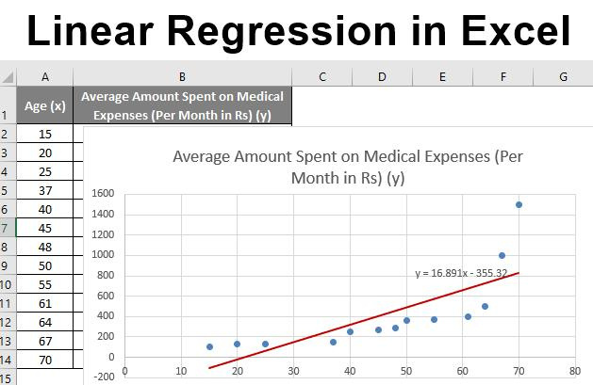
2025-07-19
What Is Regression?
Regression is a statistical method used in finance, investing, and other disciplines that attempt to determine the strength and character of the relationship between one dependent variable (usually denoted by “Y”) and a series of other variables (known as independent variables).
A regression model is able to show whether changes observed in the dependent variable are associated with changes in one or more of the explanatory variables. It does this by essentially fitting a best-fit line and seeing how the data is dispersed around this line.
Lesson - 330.2 - Introduction to Statistics Analysis and Basic Statistics for Data Analysis.pptx - 26

Slide 27
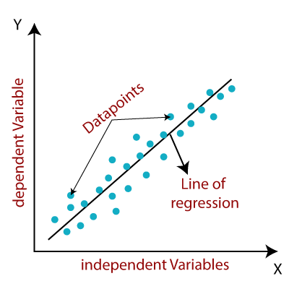
2025-07-19
Linear Regress﻿ion
Linear regression is a data analysis technique that predicts the value of unknown data by using another related and known data value. It mathematically models the unknown or dependent variable and the known or independent variable as a linear equation. For instance, suppose you have data about your expenses and income for last year. Linear regression techniques analyze this data and determine that your expenses are half of your income. They then calculate an unknown future expense by halving a future known income.
Linear regression can be further divided into two types of the algorithm:
Simple Linear Regression: If a single independent variable is used to predict the value of a numerical dependent variable.
Multiple Linear regression: If more than one independent variable is used to predict the value of a numerical dependent variable.
The linear regression model provides a sloped straight line representing the relationship between the variables. Consider the below image:
Source: analyticsvidhya.com
Lesson - 330.2 - Introduction to Statistics Analysis and Basic Statistics for Data Analysis.pptx - 27
Notes:
Since linear regression shows the linear relationship, which means it finds how the value of the dependent variable is changing according to the value of the independent variable.

Slide 28
2025-07-19
Simple Linear Regress﻿ion
Simple Linear Regression is a statistical method used to model the relationship between two variables; one independent and one dependent. It aims to find the best-fitting straight line that predicts the value of the dependent variable based on the value of the independent variable.
SLR equation:
y=a+bX+u​
where:
Y=The dependent variable you are trying to predictor explain
X=The explanatory (independent) variable(s) you are using to predict or associate with Y
a=The y-intercept
b=(beta coefficient) is the slope of the explanatoryvariable(s)
u=The regression residual or error term​
Lesson - 330.2 - Introduction to Statistics Analysis and Basic Statistics for Data Analysis.pptx - 28
Notes:
Since linear regression shows the linear relationship, which means it finds how the value of the dependent variable is changing according to the value of the independent variable.

Slide 29
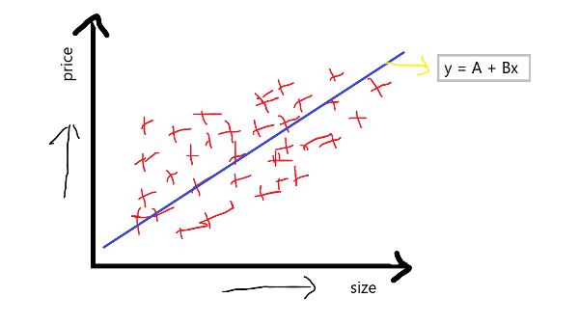
2025-07-19
Example: Simple Linear Regress﻿ion
Suppose we take a scenario of house prices where our x-axis is the size of the house, and the y-axis is the price of the house. Suppose we draw scatter points randomly. Through this scatter point, we try to find the best-fit line, which is given by the equation:
equation: y = a + bx
Suppose y is the price of the house, and x is the size of the house; then this equation seems like this:
equation: price = a + b(size)
where, a is an intercept and b is slope on that intercept
Img src: www.investopedia.com
In the above equation, the intercept indicates what the base price of the house would be when the price of the house is 0. Meanwhile, the slope or coef (coefficient) indicates the unit increase in the slope, with the unit increase in size.
Lesson - 330.2 - Introduction to Statistics Analysis and Basic Statistics for Data Analysis.pptx - 29
Notes:
Since linear regression shows the linear relationship, which means it finds how the value of the dependent variable is changing according to the value of the independent variable.

Slide 30
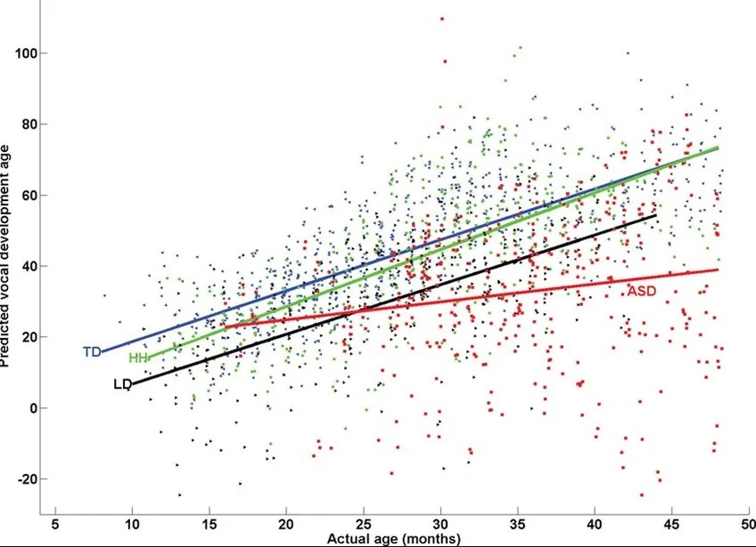
2025-07-19
Multiple Linear Regress﻿ion
Multiple Linear Regression (MLR) is an extension of Simple Linear Regression, as it takes more than one predictor variable to predict the response variable. We can define it as:
“Multiple Linear Regression is one of the important regression algorithms, which models the linear relationship between a single dependent continuous variable and more than one independent variable.”
Example: Prediction of CO2 emission based on engine size and number of cylinders in a car.
MLR formula:
Y=a+b1​X1​+b2​X2​+b3​X3​+...+bt​Xt​+u
where:
Y=The dependent variable you are trying to predictor explain.
X=The explanatory (independent) variable(s) you are using to predict or associate with Y.
a=The y-intercept.
b=(beta coefficient) is the slope of the explanatory variable(s).
u=The regression residual or error term​.
Img src: www.investopedia.com
Lesson - 330.2 - Introduction to Statistics Analysis and Basic Statistics for Data Analysis.pptx - 30
Notes:
Since linear regression shows the linear relationship, which means it finds how the value of the dependent variable is changing according to the value of the independent variable.

Slide 31
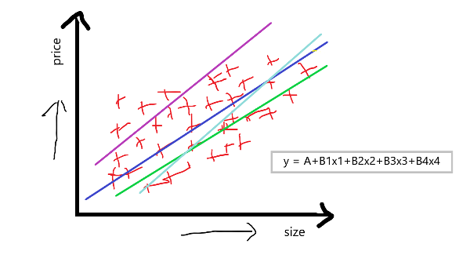
2025-07-19
Example: Multiple Linear Regress﻿ion
If we take the same example as previously discussed, suppose:
b1 is the size of the house,
b2 is bad rooms in the house,
b3 is the locality of the house,
b4 is the condition of the house, and
b5 is our output feature, which is the price of the house.
For multiple linear regression, the equation of simple linear regression y=a+bx is converted to something like this:
MLR equation:
y = A+b1x1+b2x2+b3x3+b4x4
Now our aim in using multiple linear regression is to compute a, which is an intercept. The key parameters b1, b2, b3, and b4 are the slopes or coefficients concerning this independent feature. This basically indicates that if we increase the value of x1 by 1 unit, B1 will tell you how much it will affect the price of the house. The others b2, b3, and b4, also work similarly.
Img src: www.investopedia.com
Lesson - 330.2 - Introduction to Statistics Analysis and Basic Statistics for Data Analysis.pptx - 31
Notes:
Since linear regression shows the linear relationship, which means it finds how the value of the dependent variable is changing according to the value of the independent variable.

Slide 32
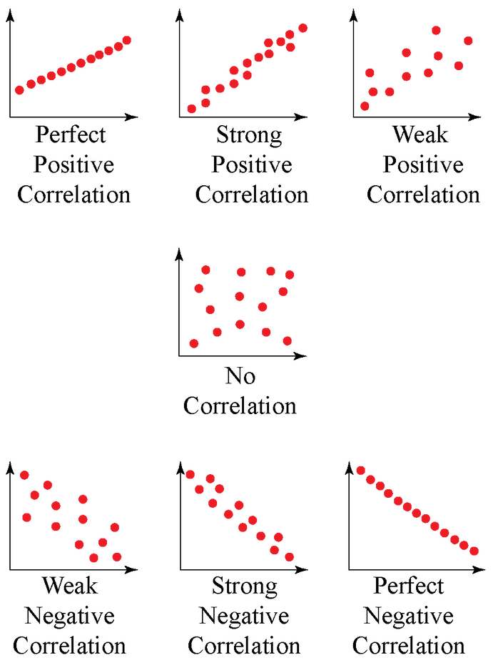
2025-07-19
Overview of Correlation
Correlation is a statistical metric for measuring to what extent different variables are interdependent. In other words, when we look at two variables over time, if one variable changes, how does this affect change in the other variable?
For example:
Lung cancer --> smoking: Smoking is known to be correlated to lung cancer since you have a higher chance of getting lung cancer if you smoke.
Rain --> Umbrella: There is a correlation between umbrella and rain variables where more precipitation means more people use umbrellas. Also, if it did not rain, people would not carry umbrellas. Therefore, we can say that umbrellas and rain are interdependent, and by definition, they are correlated.
Lesson - 330.2 - Introduction to Statistics Analysis and Basic Statistics for Data Analysis.pptx - 32
source: google.com

Slide 33
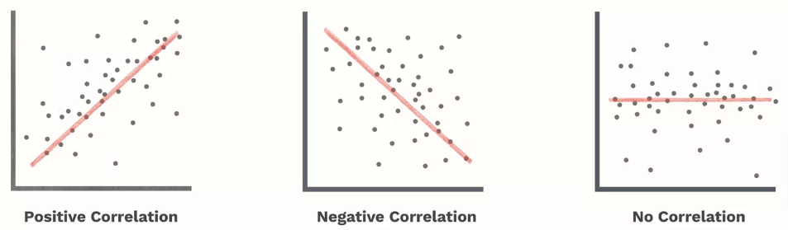
2025-07-19
Correlation Coefficie﻿nt and Covariance
Correlation Coefficient:
Quantifying the strength and direction of a linear relationship between two variables (x and y). For example, studying the correlation between study hours and exam scores.
A linear correlation coefficient that is greater than zero indicates a positive relationship. A value that is less than zero signifies a negative relationship. Finally, a value of zero indicates no relationship between the two variables.
Covariance: Measuring how much two variables change together.
Close to +1: Large Positive relationship
Close to -1: Large Negative relationship
Close to 0: No relationship
Referral: For further information on correlation, please click here.
Lesson - 330.2 - Introduction to Statistics Analysis and Basic Statistics for Data Analysis.pptx - 33

Slide 34

2025-07-19
Video: Correlation Covariance
Lesson - 330.2 - Introduction to Statistics Analysis and Basic Statistics for Data Analysis.pptx - 34

Slide 35
2025-07-19
Example: Correlation Coefficie﻿nt and Covariance
Click here to see the complete example for Correlation Coefficient and Covariance.
You can also find the lab GLAB 330.2.1 - Basic Example for Correlation Coefficient and Covariance on Canvas under the Assignment section.
Lesson - 330.2 - Introduction to Statistics Analysis and Basic Statistics for Data Analysis.pptx - 35

Slide 36

2025-07-19
Knowledge Check
What Is the purpose of Regression?
What is the difference between linear and multiple regression?
What Makes a Multiple Regression Multiple?
Lesson - 330.2 - Introduction to Statistics Analysis and Basic Statistics for Data Analysis.pptx - 36

Slide 37
2025-07-19
Summary
In this lesson, we discussed Statistical Analysis, which is the study of collection, analysis, interpretation, presentation, and organization of data. Statistics, combined with Data Mining help in better decision-making for providing measures and methodologies necessary for data mining and identifying patterns that help point to differences between random noise and significant findings.
In data analysis, two main statistical methodologies are used:
Descriptive statistics − data from the entire population or a sample is summarized with numerical descriptors (e.g., Mean or Standard Deviation for Continuous Data; Frequency or Percentage for Categorical Data).
Inferential statistics − patterns in the sample data to draw inferences about the represented population or accounting for randomness:
Answering yes/no questions about the data (hypothesis testing).
Estimating numerical characteristics of the data (estimation).
Describing associations within the data (correlation).
Modeling relationships within the data (E.g. regression analysis).
Regression is the statistical method used to determine the strength and the relation between the independent and dependent variables. Multiple Linear Regression is an extension of Simple Linear Regression, where multiple independent variables are used to predict the dependent variable.
Lesson - 330.2 - Introduction to Statistics Analysis and Basic Statistics for Data Analysis.pptx - 37

Slide 38
2025-07-19
References
McKinsey & Company. “The strategy-analytics revolution, https://www.mckinsey.com/business-functions/strategy-and-corporate-finance/our-insights/the-strategy-analytics-revolution.” Accessed August 24, 2022.
https://www.comptia.org/content/guides/what-is-data-analytics
https://www.coursera.org/articles/what-is-data-analysis-with-examples
https://online.hbs.edu/blog/post/data-wrangling
https://brainalyst.in/hypothesis-testing/
https://www.cuemath.com/data/how-to-calculate-correlation-coefficient/
https://online.stat.psu.edu/stat501/lesson/1/1.1
https://eng.libretexts.org/Bookshelves/Industrial_and_Systems_Engineering/Chemical_Process_Dynamics_and_Controls_%28Woolf%29/13%3A_Statistics_and_Probability_Background/13.01%3A_Basic_statistics-_mean_median_average_standard_deviation_z-scores_and_p-value
Lesson - 330.2 - Introduction to Statistics Analysis and Basic Statistics for Data Analysis.pptx - 38

Slide 39
2025-07-19
Questions?
Lesson - 330.2 - Introduction to Statistics Analysis and Basic Statistics for Data Analysis.pptx - 39

